Slide 1
What is Racism?
Stage 1-3 LS

Slide 2
Learning intention
Introduce the concept of diversity and promote understanding, and foster inclusivity among students.
We will do this through the following activities:
  Discussion
  All About Me activity
  Diversity exploration
  Sorting activity or illustration cards

Slide 3
This is a safe space
This is a safe place where no one will judge you for what you say or think. It's okay to make mistakes, but it's important to recognise and learn from them.
Let's talk about how we can respect each other while we learn together...

Slide 4
Activity 01
Discussion

Slide 5
Our differences are what makes our world interesting and beautiful
Notes:
Opening Discussion – Our differences are what makes us unique and beautiful? (5-10mins)
Explain to students that today the class will be discussing the important topics of diversity and racism. Gauge student understanding and connections to the topic though some brief questioning or a show of hands indicating who has heard these words before.
Remind students to be respectful and steer responses away from personal experiences or individual people.
Follow on with a 5min discussion using the following prompts:
What makes each of us special and unique?
How do you feel when someone is mean or unkind to you?
Have you ever seen someone being treated unfairly? How did it make you feel?
Why is it important to be kind to everyone?

Slide 6
Activity 02
All About Me

Slide 7
All About Me
The best way to learn about diversity is by sharing what makes us special.
Fill in the worksheet for Activity 1
Now compare your page with a friend.
  How are they different?
  How are they the same?
  Can you find anyone with exactly the same answers as you?
Notes:
In this activity, students draw or list features about themselves that makes them unique. Encourage students to think about what makes them special, such as; their hobbies, talents, family, favourite things and interests.
After completing their worksheets, invite students to share and explain their artwork with a friend or partner, asking students to consider:
How are they different?
How are they the same?
Can you find anyone with exactly the same answers as you?

Slide 8
Activity 03
Diversity Exploration

Slide 9

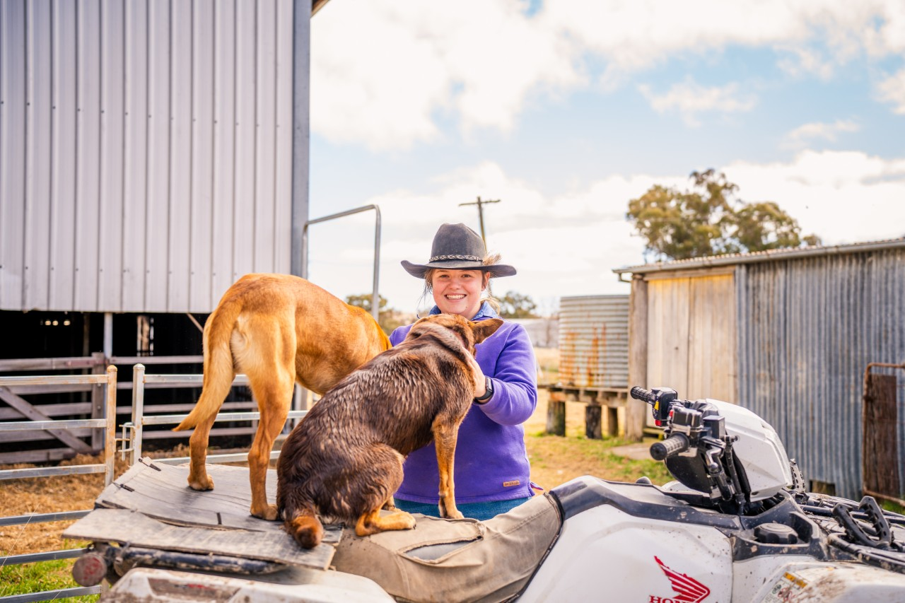
What do you see?
Image © State of New South Wales (Department of Education) 2023
Notes:
Caring for animals
Describe what is in the picture
How is it similar or different to the other pictures
What connections can you make?

Slide 10
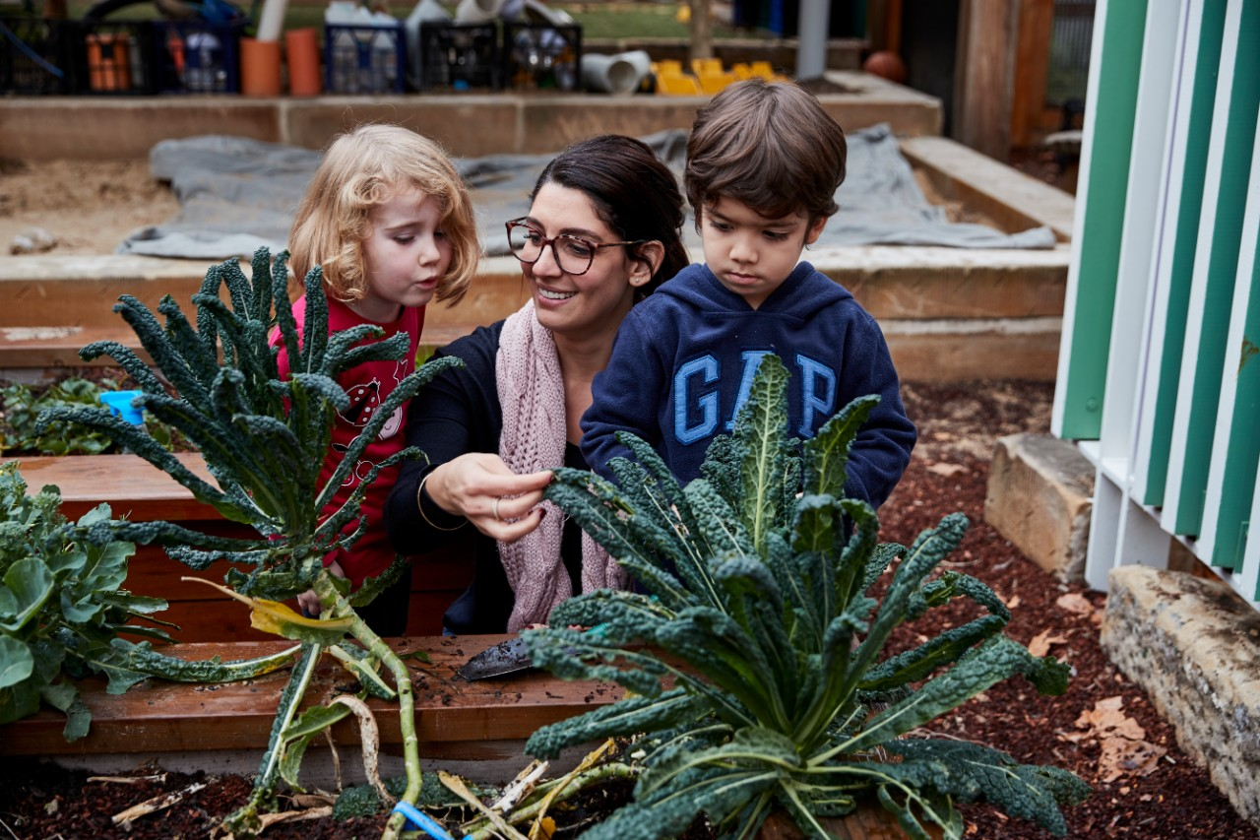
What do you see?
Image © State of New South Wales (Department of Education) 2023
Notes:
Growing food
Describe what is in the picture
How is it similar or different to the other pictures
What connections can you make?

Slide 11
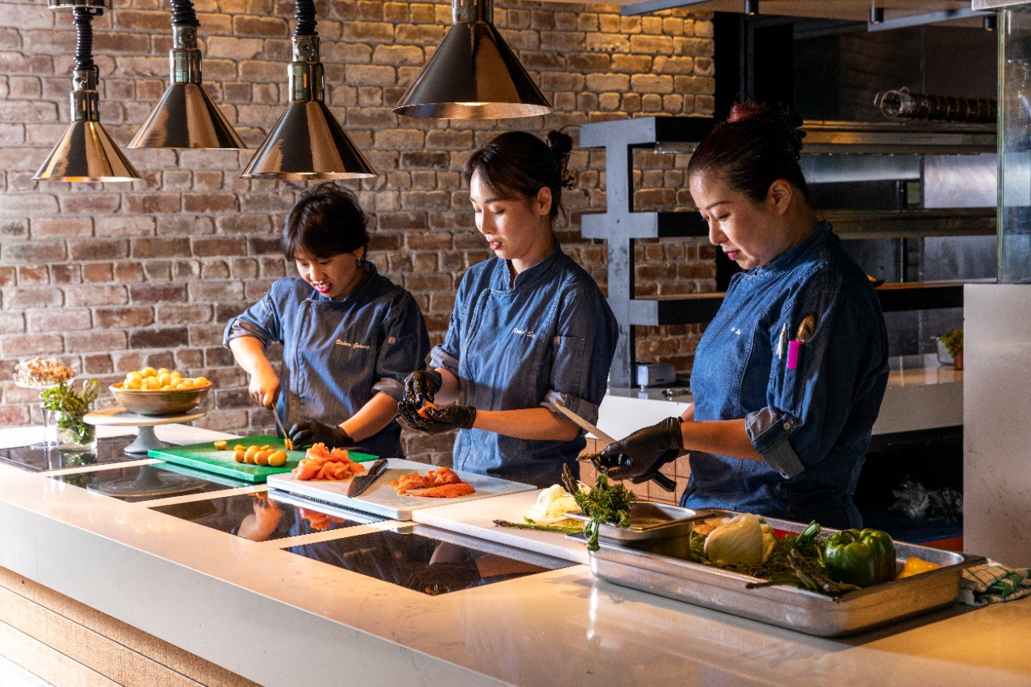
What do you see?
Image © State of New South Wales (Department of Education) 2023
Notes:
Chefs at a resturant
Describe what is in the picture
How is it similar or different to the other pictures
What connections can you make?

Slide 12
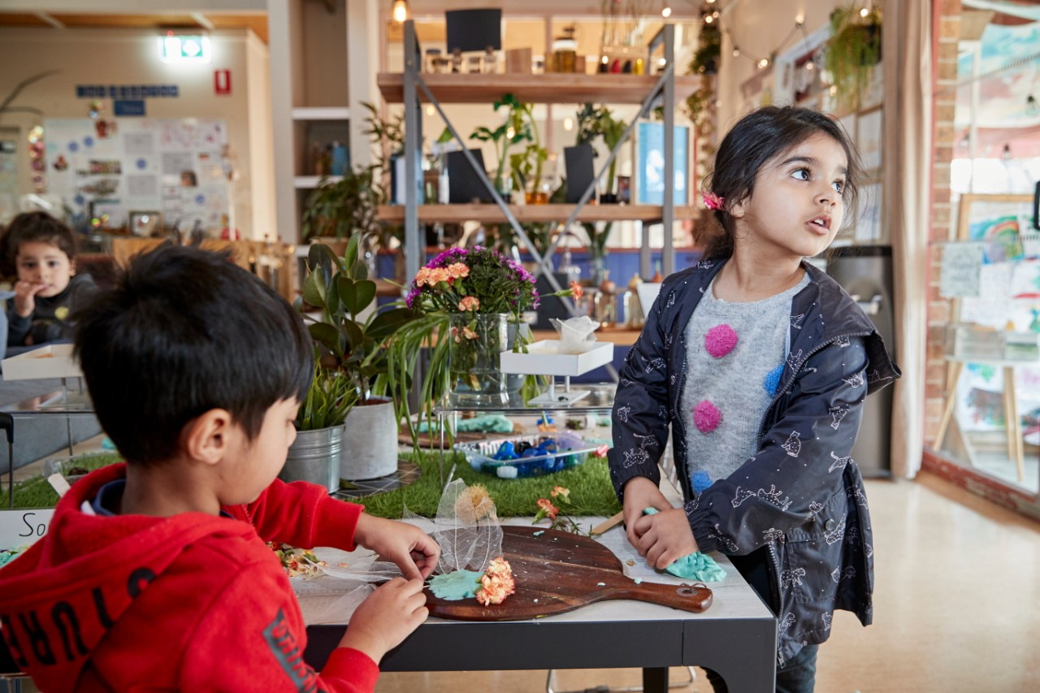
What do you see?
Image © State of New South Wales (Department of Education) 2023
Notes:
Playing with siblings
Describe what is in the picture
How is it similar or different to the other pictures
What connections can you make?

Slide 13
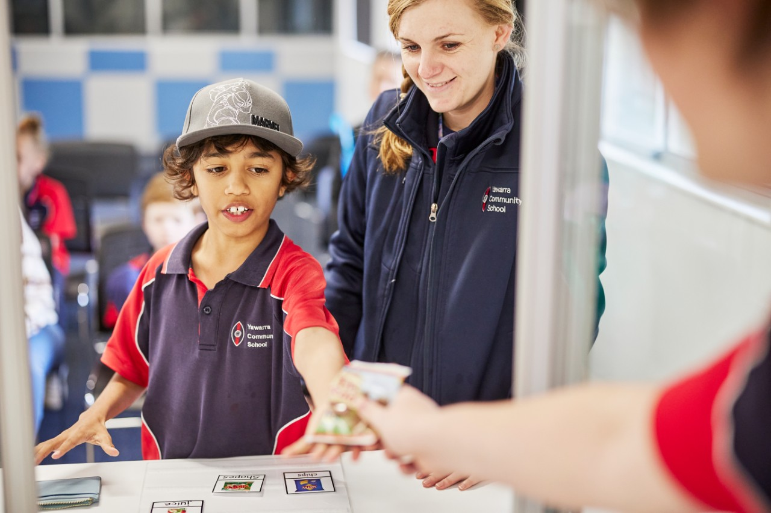
What do you see?
Image © State of New South Wales (Department of Education) 2023
Notes:
Learning at school
Describe what is in the picture
How is it similar or different to the other pictures
What connections can you make?

Slide 14
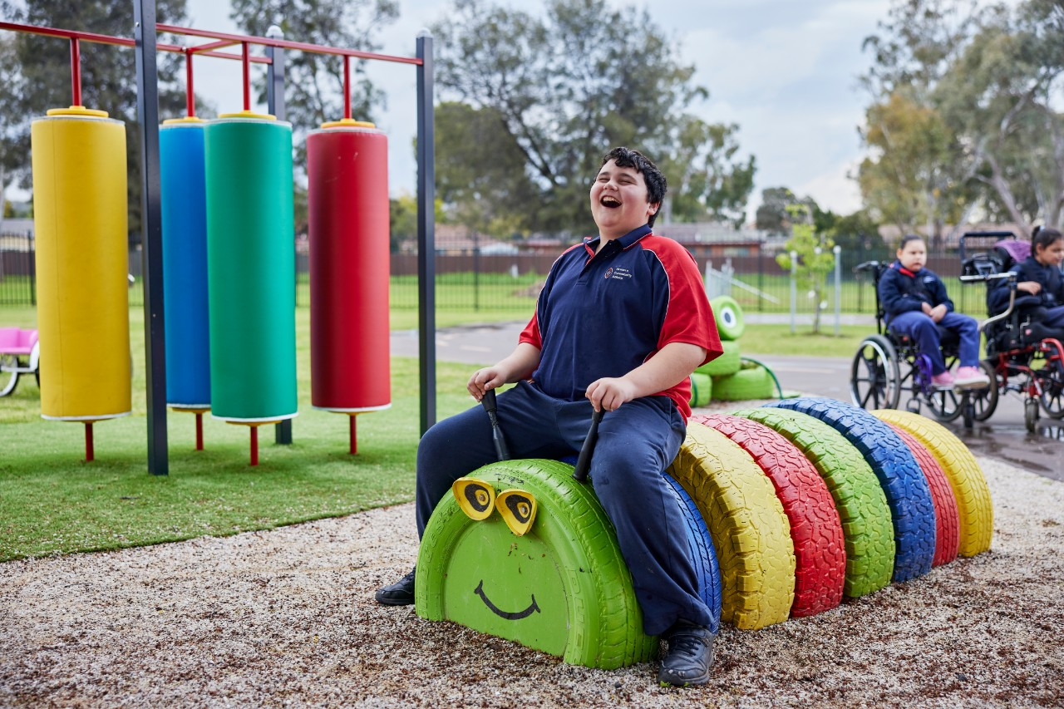
What do you see?
Image © State of New South Wales (Department of Education) 2023
Notes:
Playing on the playground
Describe what is in the picture
How is it similar or different to the other pictures
What connections can you make?

Slide 15
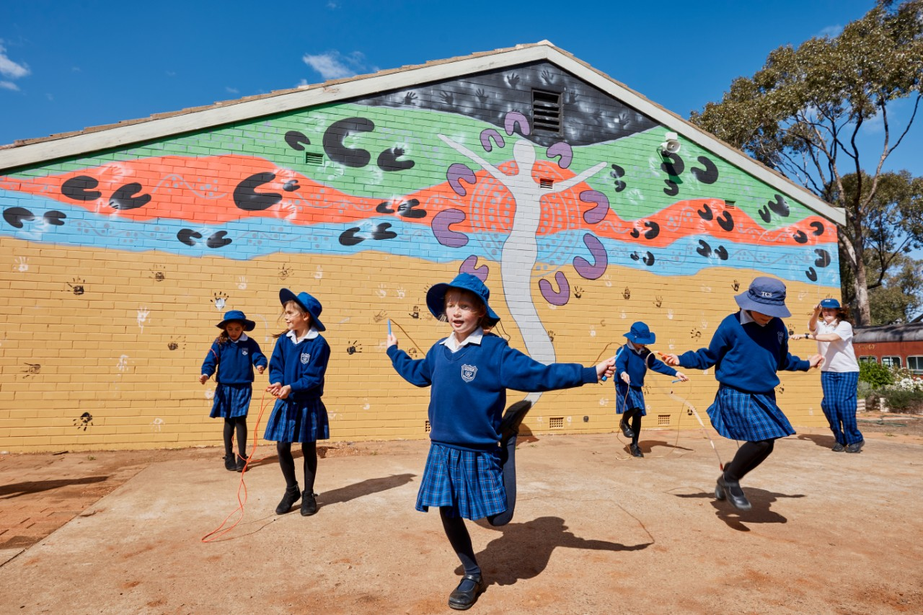
What do you see?
Image © State of New South Wales (Department of Education) 2023
Notes:
At recess and lunchtime
Describe what is in the picture
How is it similar or different to the other pictures
What connections can you make?

Slide 16
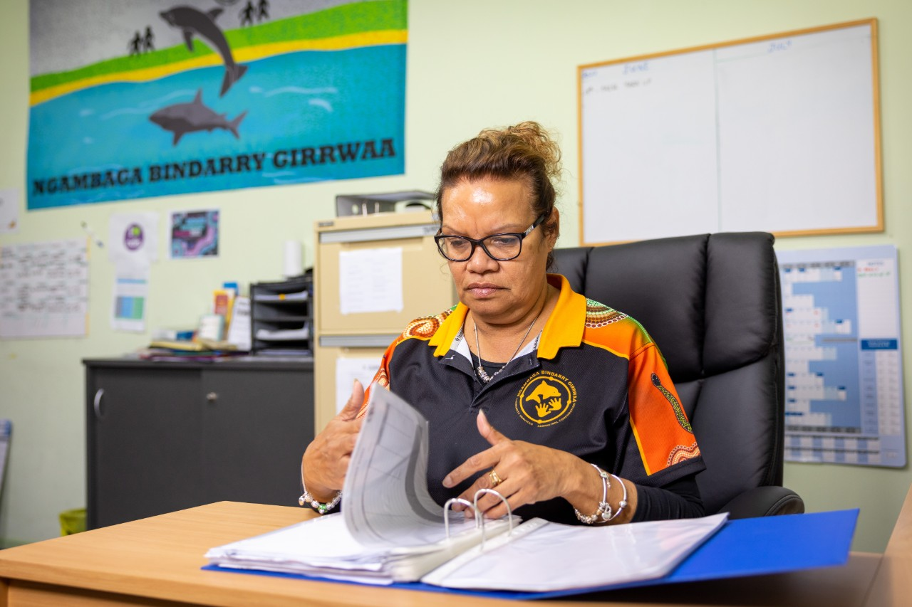
What do you see?
Image © State of New South Wales (Department of Education) 2023
Notes:
Working in an office
Describe what is in the picture
How is it similar or different to the other pictures
What connections can you make?

Slide 17
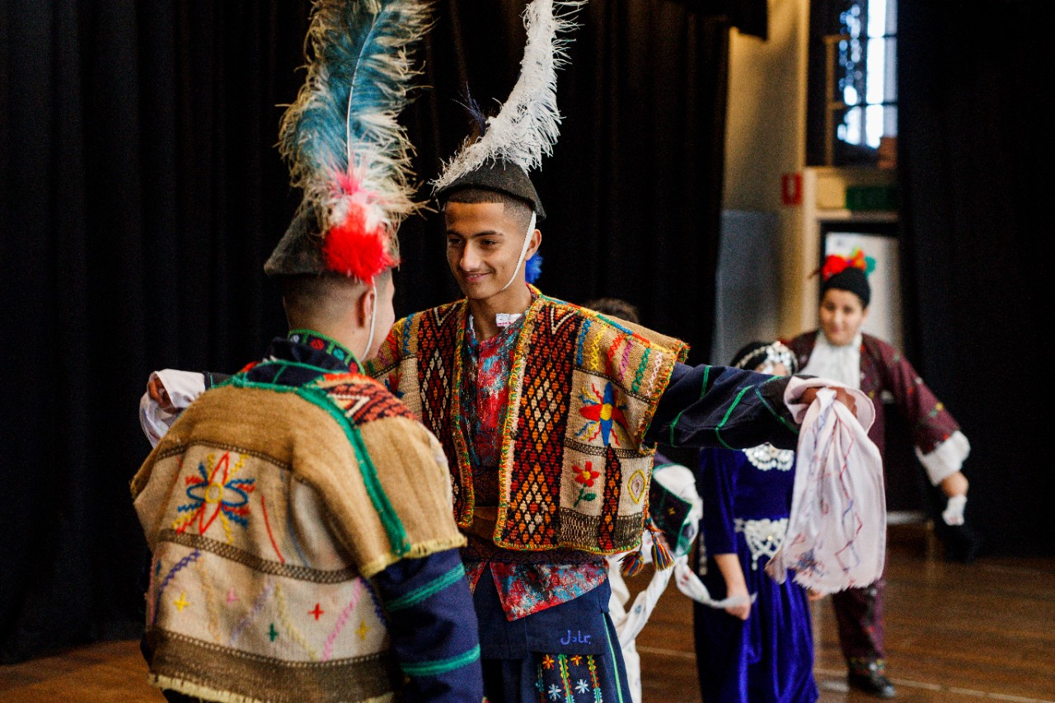
What do you see?
Image © State of New South Wales (Department of Education) 2023
Notes:
Cultural celebration/performance at school
Describe what is in the picture
How is it similar or different to the other pictures
What connections can you make?

Slide 18
Activity 04
Understanding Racism

Slide 19
Understanding Racism
Racism is when people treat others badly or unfairly because of the colour of their skin or where they come from. It's important to be kind to everyone and treat them with respect, no matter what they look like.
Notes:
Reiterate to students that our differences are what makes our world beautiful.
Introduce the concept of racism as when people treat others badly or unfairly because of the colour of their skin or where they come from. It's important to be kind to everyone and treat them with respect, no matter what they look like.

Slide 20
Activity 05
Worksheet options:
Illustration Cards or Sorting Activity

Slide 21
End of Lesson One

