Slide 1
What is Racism?
Stage 4-6 LS

Slide 2
Learning Intention
To learn more about what racist behaviour is and identify it when we see it at school, at home, online, or in the community.
We will do this through the following activities:
  Reading
  Video clip
  True or False game
  The shape of racism
  Glossary activity
  Cloze passage

Slide 3
This is a safe space
This is a safe place where no one will judge you for what you say or think. It's okay to make mistakes, but it's important to recognise and learn from them.
Let's talk about how we can respect each other while we learn together...
Notes:
Prompt students to share some ways that they can be respectful in this learning environment. Responses will be specific to different learning environments, but some could include:
Taking turns
Listening to one another
Not raising voices
Reading body signs
If you think a term or word will be hurtful, don't use it

Slide 4
Activity 01
Brainstorm

Slide 5
What do we already know about racism?
Notes:
Gauge student understanding of topic at the start of the lesson by asking some broad questions. Remind students to be respectful and steer responses away from personal experiences or individual people.
Discussion questions:
Who experiences racism?
Where does racism happen?
Does racism only happen online, or can it happen at school too?
Why is racism a problem?
Have you heard of the term ‘bystander’?
What could you do if you see racism happing at school/at the shops/online?

Slide 6
So...What is Racism?
Racism is when one group in society believes they are better than other groups and treats them unfairly.
This can be based on differences like:
The colour of their skin
The language they speak
The country they (or their parents) were born in
The food they eat
Their culture or the religion they follow

Slide 7
Activity 02
Let's Talk About Racism

Slide 8
True or False? - Heads or Hips?
The next slides will show some statements. Show your understanding by following these steps:
Stand up where you are
Wait for your teacher to read the statement
Show your answer by putting your hands on your heads if true or your hips if false.

Slide 9
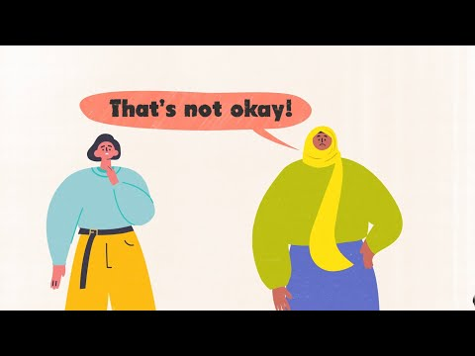
Let's Talk About Racism
Watch the first two segments of this clip (1:45) to understand more about what Racism is.
Notes:
Watch the first two segments of the Australian Human Rights Commission’s video about racism. Use this information to guide students through the True or False game embedded in the following slides.

Slide 10
Treating someone unfairly because of the colour of their skin is an example of racism.
Heads (true) | Hips (false)

Slide 11
Treating someone unfairly because of the colour of their skin is an example of racism.
Heads (true)
That’s right! Racism is when one group in society think they are better than another because of the colour of their skin and use this as a reason to treat others unfairly.

Slide 12
Australia has laws to make sure people who were born in another country are not treated unfairly.
Heads (true) | Hips (false)

Slide 13
Australia has laws to make sure people who were born in another country are not treated unfairly.
Heads (true)
Nice one! Australia's Racial Discrimination Act (1975) says everyone should be treated equally, no matter what country you are born in, language you speak, or the colour of your skin.

Slide 14
Bullying or making fun of someone because of the language they speak is not racist.
Heads (true) | Hips (false)

Slide 15
Bullying or making fun of someone because of the Food they eat is not racist.
Hips (false)
Correct! Treating anyone unfairly because they might eat different foods to what you are used to is an example of racism.

Slide 16
Discrimination is when a group of people are treated badly or unfairly because of who they are.
Heads (true) | Tails (false)

Slide 17
Discrimination is when a group of people are treated badly or unfairly because of who they are.
Heads (true)
You got it! Racism is a form of discrimination. Treating anyone unfairly because of differences like where they were born, what they look like, or the colour of their skin is an example of discrimination.

Slide 18
Shop owners can ask a person to leave if they don't like the language they are speaking, or their accent.
Last one!
Heads (true) | Hips (false)

Slide 19
Shop owners can ask a person to leave if they don't like the language they are speaking, or their accent.
Last one!
Hips (false)
Correct! Everyone should be treated equally, no matter what country you are born in, language you speak, or the colour of your skin. Treating someone unfairly because they speak a different language is an example of racism.

Slide 20
Activity 03
The Different Shapes That Racism Can Take

Slide 21
The different shapes that racism can take
comments
Government policies
name calling
jokes
physical violence
intimidation
harassment
Notes:
Racism can take many forms (or shapes), ranging from jokes and comments to physical violence. Racism can have a direct or indirect impact on whether or not people access services, employment, education, sport, public spaces and social activities.
In this activity, ask students to come to the board and select - by pointing or shading in with a whiteboard marker- the different shapes that they think racism can take.
Use the following discussion points to support student reflection on these forms of racism:
Is racism Intentional or can it be unintentional?
How jokes, which are supposed to be funny, can cause offence or hurt
The kinds of places that these forms of racism may come from – e.g. media, online, memes etc.
How might government policies perpetuate inequalities?

Slide 22
Activity 04
Glossary Activities

Slide 23
Activity 05
Exploring Individual and Systemic Racism

Slide 24
End of lesson one

