Slide 1
Close Study of a Song
Stage 1-3 LS

Slide 2
Learning intention
Students will gain a deeper understanding of contemporary Australian socio-political events with a focus on racism in sport. Students will explore how music can provide a voice to minority groups.
We will do this through the following activities:
  Word Mat
  Feelings and Emotions
  Close study of lyrics
  What would you do?

Slide 3
This is a safe space
This is a safe place where no one will judge you for what you say or think. It's okay to make mistakes, but it's important to recognise and learn from them.
Let's talk about how we can respect each other while we learn together...

Slide 4
Understanding Racism
Racism is when people treat others badly or unfairly because of the colour of their skin or where they come from. It's important to be kind to everyone and treat them with respect.
Notes:
Reiterate to students that our differences are what makes our world beautiful.
Restate the concept of racism as when people treat others badly or unfairly because of the colour of their skin or where they come from. It's important to be kind to everyone and treat them with respect.
Make the point that sometimes, this unfair treatment is built into rules, laws or systems that give more power to one group over others.

Slide 5
Activity 01
Music Word Mat

Slide 6
Music has the power to....
Bring Joy
Unite
Share feelings
Teach
Inspire
Bring comfort
Help us speak up
Motivate
Make change
Entertain
Empower
Notes:
In this activity, ask students to come to the board and select - by pointing or circling with a whiteboard marker- words that describe the impact of music. Select students to justify their answers.

Slide 7
Activity 02
Feelings and Emotions

Slide 8
Feelings Cards
Follow your teacher's instructions to create a set of feelings cards.
Then use them to identify and share the way different music makes you feel.
Notes:
Distribute blank Feelings and Emotions Cards and pencils and support students to draw a face corresponding to each emotion on the card. Play a selection of age-appropriate songs and ask students to stop, listen and think about how the song makes them feel. Prompt students to select the appropriate card and hold it up to show their feelings.
Finally, play “Every Step of the Way” by Paul Kelly, and do the same.

Slide 9
To listen to "Every Step of the Way" by Paul Kelly

Slide 10
Activity 03
Close Study of Lyrics - "Every Step of the Way" by Paul Kelly

Slide 11

Who is Paul Kelly?
"Paul Kelly at Rockwood Music Hall" by Tim Pierce is licensed under CC BY 2.0.
Notes:
Paul Kelly is an Australian singer and songwriter. He writes and plays songs about life in Australia. He reached out to Eddie Betts and asked if he could share the song he had written about Eddie Betts' experiences of racism.

Slide 12
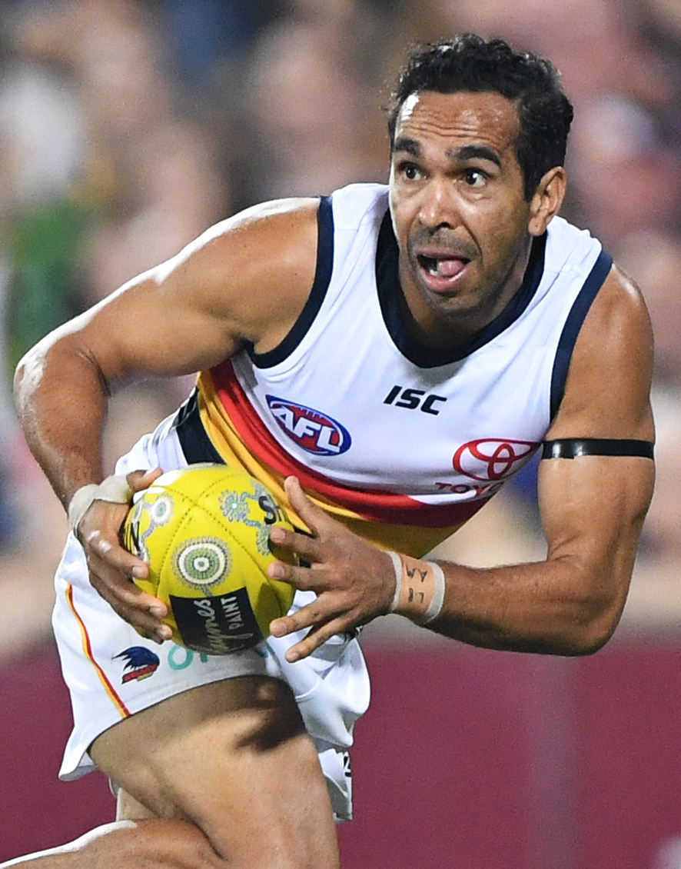
Who is Eddie Betts?
"Eddie Betts 2019.6" by Flickerd is licensed under CC BY-SA 4.0.
Notes:
Eddie Betts is a proud Gabrun and Nunga man who grew up between WA and SA. He started playing AFL for Carlton in 2005 but retired from football in 2021. During this time as a professional footballer, Eddie Betts experienced racism on and off the field. Eddie Betts has long been a prominent voice against racism in Australia.

Slide 13
Move the boxes to match these phrases from the lyrics to their meaning
Curse
Being an impressive player
Climb awkwardly
Congratulate or praise me
Wishing harm on somebody
A way of understanding something
Clamber
Slap my back
Perspective
Dancing feet

Slide 14
Create some actions
Listen to stanza four of the song again and think about the lyrics.
Now create a series of actions or dance movements to represent what Paul Kelly is singing about.

Slide 15
Lyrics summary
What is this song mostly about? Share your answers here

Slide 16
Activity 04
What would you do?

Slide 17
What are some things you could do if you witness racism at home, at school, online or in the community?
report it to a parent, teacher or trusted adult
Be a bystander
Be an upstander
Notes:
In closing, students are prompted to share how they would respond if they witnessed racism in the community (e.g. at a football game). Some prompts have been provided on the slides. Explain what an upstander and a bystander is. A bystander is someone who witnesses racism but does not take any action (support the target, stop the negative behaviour, report the behaviour).
An upstander is someone who intervenes and/or provides support to the target of racism.
Consider giving an example of what a student can do or say as an upstander.
It is important that students know that they can intervene when it is safe to do so.
Consider reviewing What can you do? | English Life Skills and PDHPE Life Skills for additional ideas.

Slide 18
End of Lesson

